Slide 1
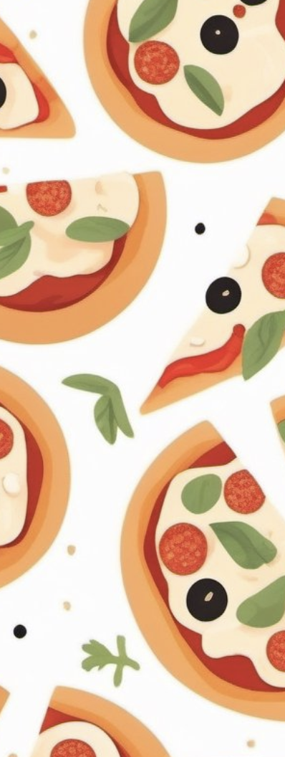
Gruppe F - Pizzeria
“Part of the secret of success in life is to eat what you like and let the food fight it out inside.” - Mark Twain
Solvej, Liv & Caroline

Slide 2
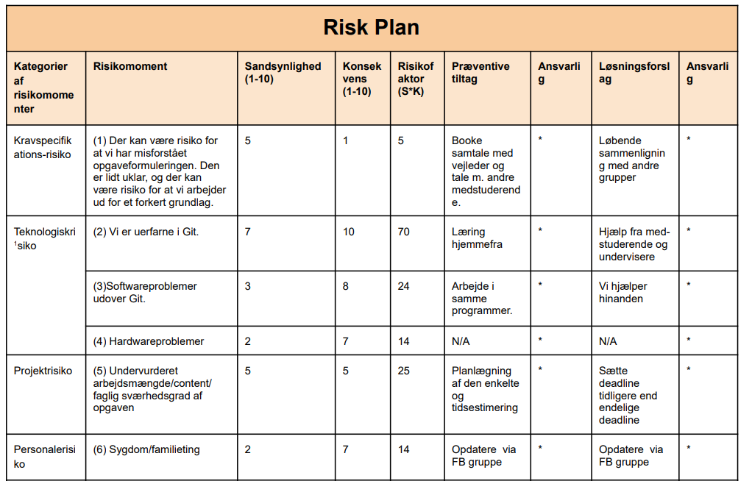

Slide 3
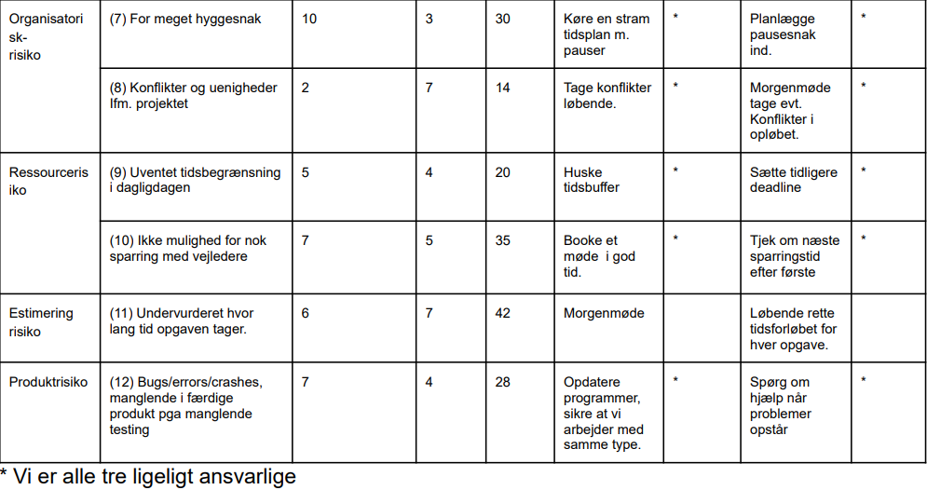

Slide 4
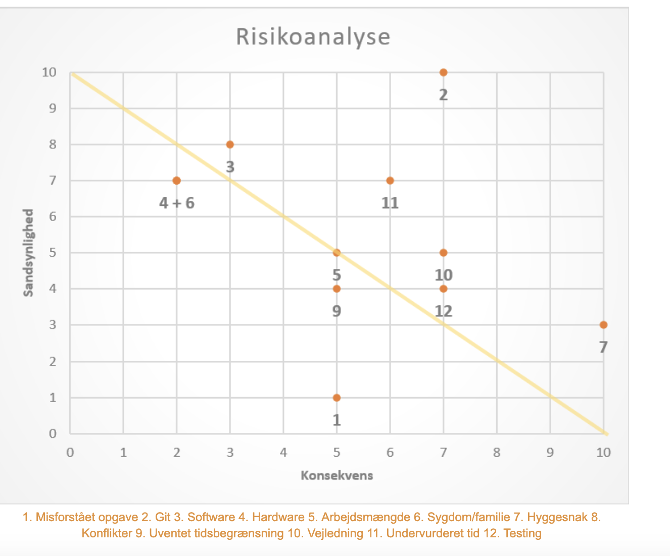
Risk Analysis
Git
Software
Hyggesnak
Vejledning
Undervurderet tid
Testing

Slide 5
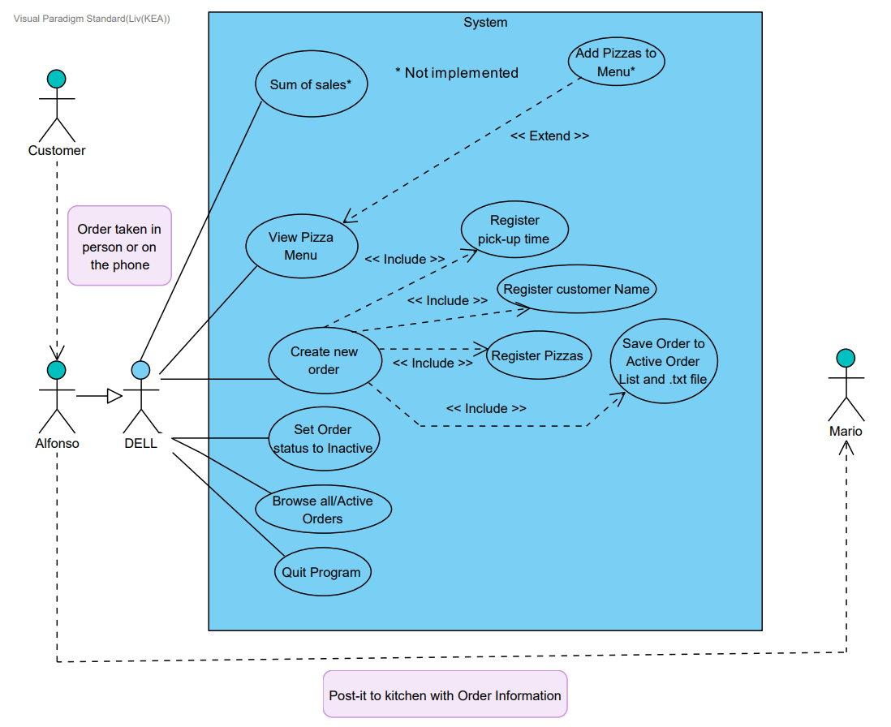
Use Case Diagram

Slide 6
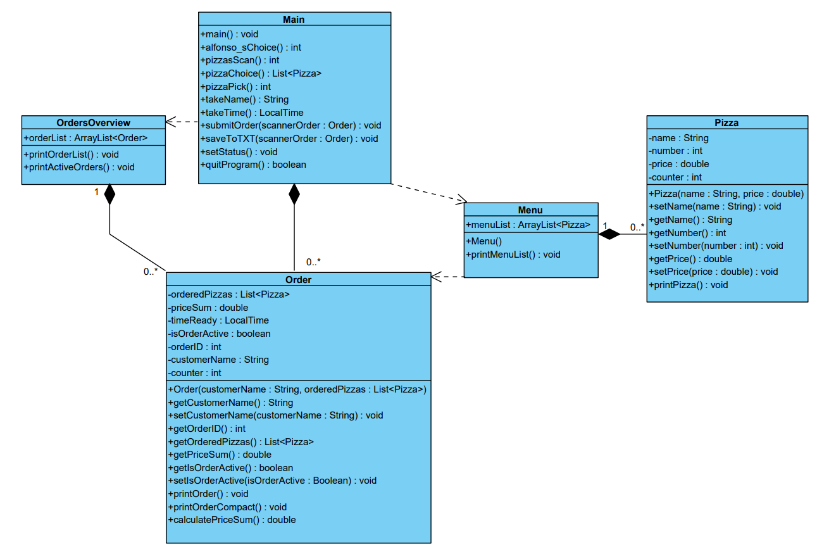
Class Diagram

Slide 7
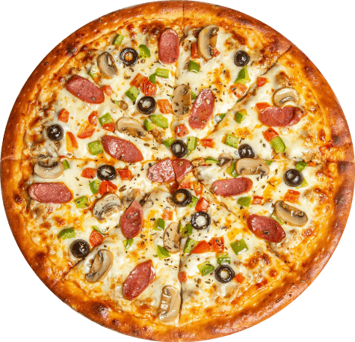
Classes
Order
Main
Pizzeria
Order Overview
Menu
Pizza
Questions?

